Slide 1
Chapter 14
Project Closure

Slide 2
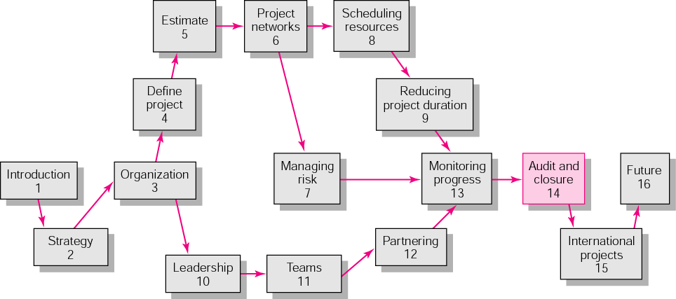
Copyright © 2006 The McGraw-Hill Companies. All rights reserved.
McGraw-Hill/Irwin 14–<number>

Slide 3
Content
Types of Project Closure
Wrap-up Closure Activities
Post-Implementation Evaluation
Retrospective
Key terms
Copyright © 2006 The McGraw-Hill Companies. All rights reserved.
McGraw-Hill/Irwin 14–<number>
Notes:
Closing out a project includes a daunting number of tasks.
Three major deliverables for project closure:
Wrapping up the project → ensure the project is approved and accepted by the customer, closing accounts, paying bills, reassigning equipment and personnel, finding new opportunities…
Evaluation of performance and management of the project → team, individual team members, project manager
Retrospectives of lesson learned → improve performance on current and future projects

Slide 4

Project Closure
Conditions for Closure
  Normal
  Premature
  Perpetual
  Failed Project
  Changed Priority
Close-out Plan: Questions to be Asked
  What tasks are required to close the project?
  Who will be responsible for these tasks?
  When will closure begin and end?
  How will the project be delivered?
Copyright © 2006 The McGraw-Hill Companies. All rights reserved.
McGraw-Hill/Irwin 14–<number>
Notes:
1) Normal → most circumstance: the completed project with some modifications in scope, cost, or schedule.
2) Premature → complete early with some parts of the project eliminated. For example, we might jump to production before testing in a new product development project to catch the opportunity (the implication and risks associated with this decision should be carefully reviewed. However, the large profit always goes along with large risks).
3) Perpetual → some project never seems to end → add-ons → poorly conceived project scope → should recommend methods for bringing final closure and initiating another project.
4) Failed project → usually easy to identify and easy for a review group to close down
5) Changed priority → strategy shifts directions → projects in process may need to be altered or canceled

Slide 5
Implementing Closedown
Getting delivery acceptance from the customer.
Shutting down resources and releasing to new uses.
Reassigning project team members.
Closing accounts and seeing all bills are paid.
Evaluating the project team, project team members, and the project manager.
Copyright © 2006 The McGraw-Hill Companies. All rights reserved.
McGraw-Hill/Irwin 14–<number>
Notes:
The major challenges for the project manager and team members are over (in executing phase). Now, it’s time to wrap-up the odds and ends to fully complete the project. It’s often difficult like deciding who will clean up after a party while keeping them motivated with those cleaning stuff.
There are some Wrap-up closure activities a project team must accomplish in this phase:…

Slide 6
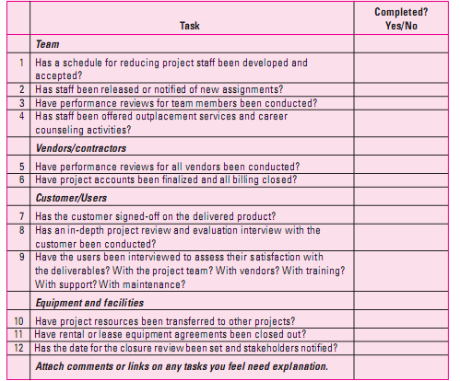
Wrap-up Closure Checklist
Notes:
This is a sample of wrap-up closure checklist. And this is only a partial checklist. Some organizations even have checklists of over 100 wrap-up tasks!
These checklists deal with closure details such as team, contactors, customers, facilities, and the project itself.

Slide 7
Creating the Final Report
Execute Summary
Review and Analysis
Recommendations
Lesson Learned
Appendix
Copyright © 2006 The McGraw-Hill Companies. All rights reserved.
McGraw-Hill/Irwin 14–<number>

Slide 8

Project Performance Evaluations
Reasons for Poor-Quality Project Performance Evaluations:
  Evaluations of individuals are still left to supervisors of the team member’s home department.
  Typical measures of team performance center on time, cost, and specifications.
Copyright © 2006 The McGraw-Hill Companies. All rights reserved.
McGraw-Hill/Irwin 14–<number>
Notes:
Project evaluation → to assess how will the project team, team members, and project manager performed

Slide 9
Project Performance Evaluation: Team
Are standards and goals for measuring performance Clear, challenging, and attainable? Lead to positive consequences?
Are responsibilities and performance standards known by all team members?
Are team rewards adequate? Management believes teams are important?
Is there a career path for successful project managers
Does the team have discretionary authority to manage short-term difficulties?
Is there a high level of trust within the organization culture?
Are there criteria beyond time, cost, and specifications?
Copyright © 2006 The McGraw-Hill Companies. All rights reserved.
McGraw-Hill/Irwin 14–<number>

Slide 10
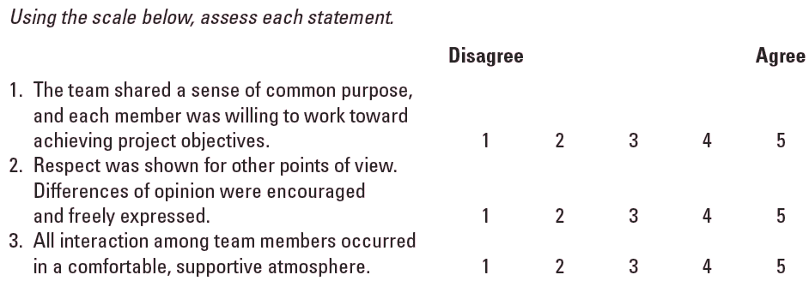
Sample Team Evaluation
and Feedback Survey
TABLE 14.3
Copyright © 2006 The McGraw-Hill Companies. All rights reserved.
McGraw-Hill/Irwin 14–<number>

Slide 11
Project Performance Evaluation: Individual
Responsibility for assessing performance
  Functional organization or functional matrix: the individual’s area manager.
    The area manager may solicit the project manager’s opinion of the individual’s performance on a specific project.
  Balanced matrix: the project manager and the area manager jointly evaluate an individual’s performance.
  Project matrix and project organizations: the project manager is responsible for appraising individual performance.
Copyright © 2006 The McGraw-Hill Companies. All rights reserved.
McGraw-Hill/Irwin 14–<number>

Slide 12

Project Performance Evaluation: Individual
Multirater appraisal or the “360-degree feedback”
  Involves soliciting feedback concerning team members’ performance from all the people their work affects.
  This includes project managers, area managers, peers, subordinates, and even customers.
Copyright © 2006 The McGraw-Hill Companies. All rights reserved.
McGraw-Hill/Irwin 14–<number>

Slide 13
Conducting Performance Reviews
Begin by asking the individual to evaluate his or her own performance.
Avoid drawing comparisons with other team members; rather, assess the individual in terms of established standards and expectations.
Focus criticism on specific behaviors rather than on the individual personally.
Be consistent and fair in your treatment of all team members.
Treat the review as one point in an ongoing process.
Copyright © 2006 The McGraw-Hill Companies. All rights reserved.
McGraw-Hill/Irwin 14–<number>

Slide 14
Retrospectives
Initiating the Retrospective Review
Selection of a Facilitator
Managing a Retrospective
Overseeing a Post-Project Retrospective
Utilization of Retrospectives
Archiving Retrospectives
Concluding Retrospective Notes
Copyright © 2006 The McGraw-Hill Companies. All rights reserved.
McGraw-Hill/Irwin 14–<number>
Notes:
Should be set up in the project planning stage – before the project begins
The retrospective methodology uses an independent facilitator to collect and implement lessons learned to improve management of current and future projects

Slide 15
Key Terms
Performance review
Project closure
Team evaluation
Three hundred and sixty
degree feedback
Copyright © 2006 The McGraw-Hill Companies. All rights reserved.
McGraw-Hill/Irwin 14–<number>

